Slide 1
Status Belgian e-commerce

Slide 2
Table of Contents
Growth of the Market
Best performing sectors
Export
Appendix
About Becom
Methodology & Definitions Market Monitor
Methodology & Definitions E-commerce Barometer

Slide 3
Overview of 2023
Volume
€14,7 billion
Transactions
170,3 million
Online Buyers
8,4 million
2022
+10,7%
+0,3%
-0,6%
Volume
€16,27 billion
Transactions
170,8 million
Online Buyers
8,5 million
2023

Slide 4
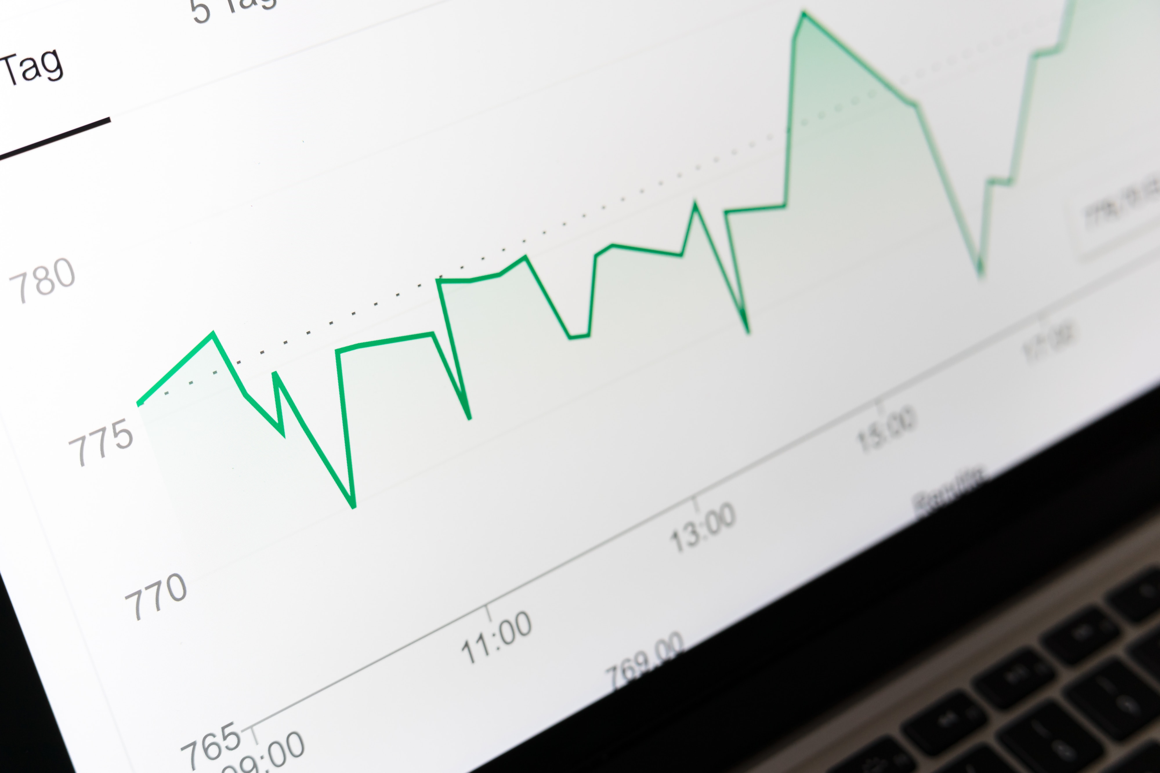
Growth of the market

Slide 5
Compared to 2019, 4.8 billion euros more is now being spent online
Total Market: offline vs. online

Slide 6
The services have recovered from the corona dip
The total services market: offline vs. online
67,7%
65,9%
66,3%
60,9%
62,6%
33,7%
37,4%
39,1%
34,1%
32,3%

Slide 7
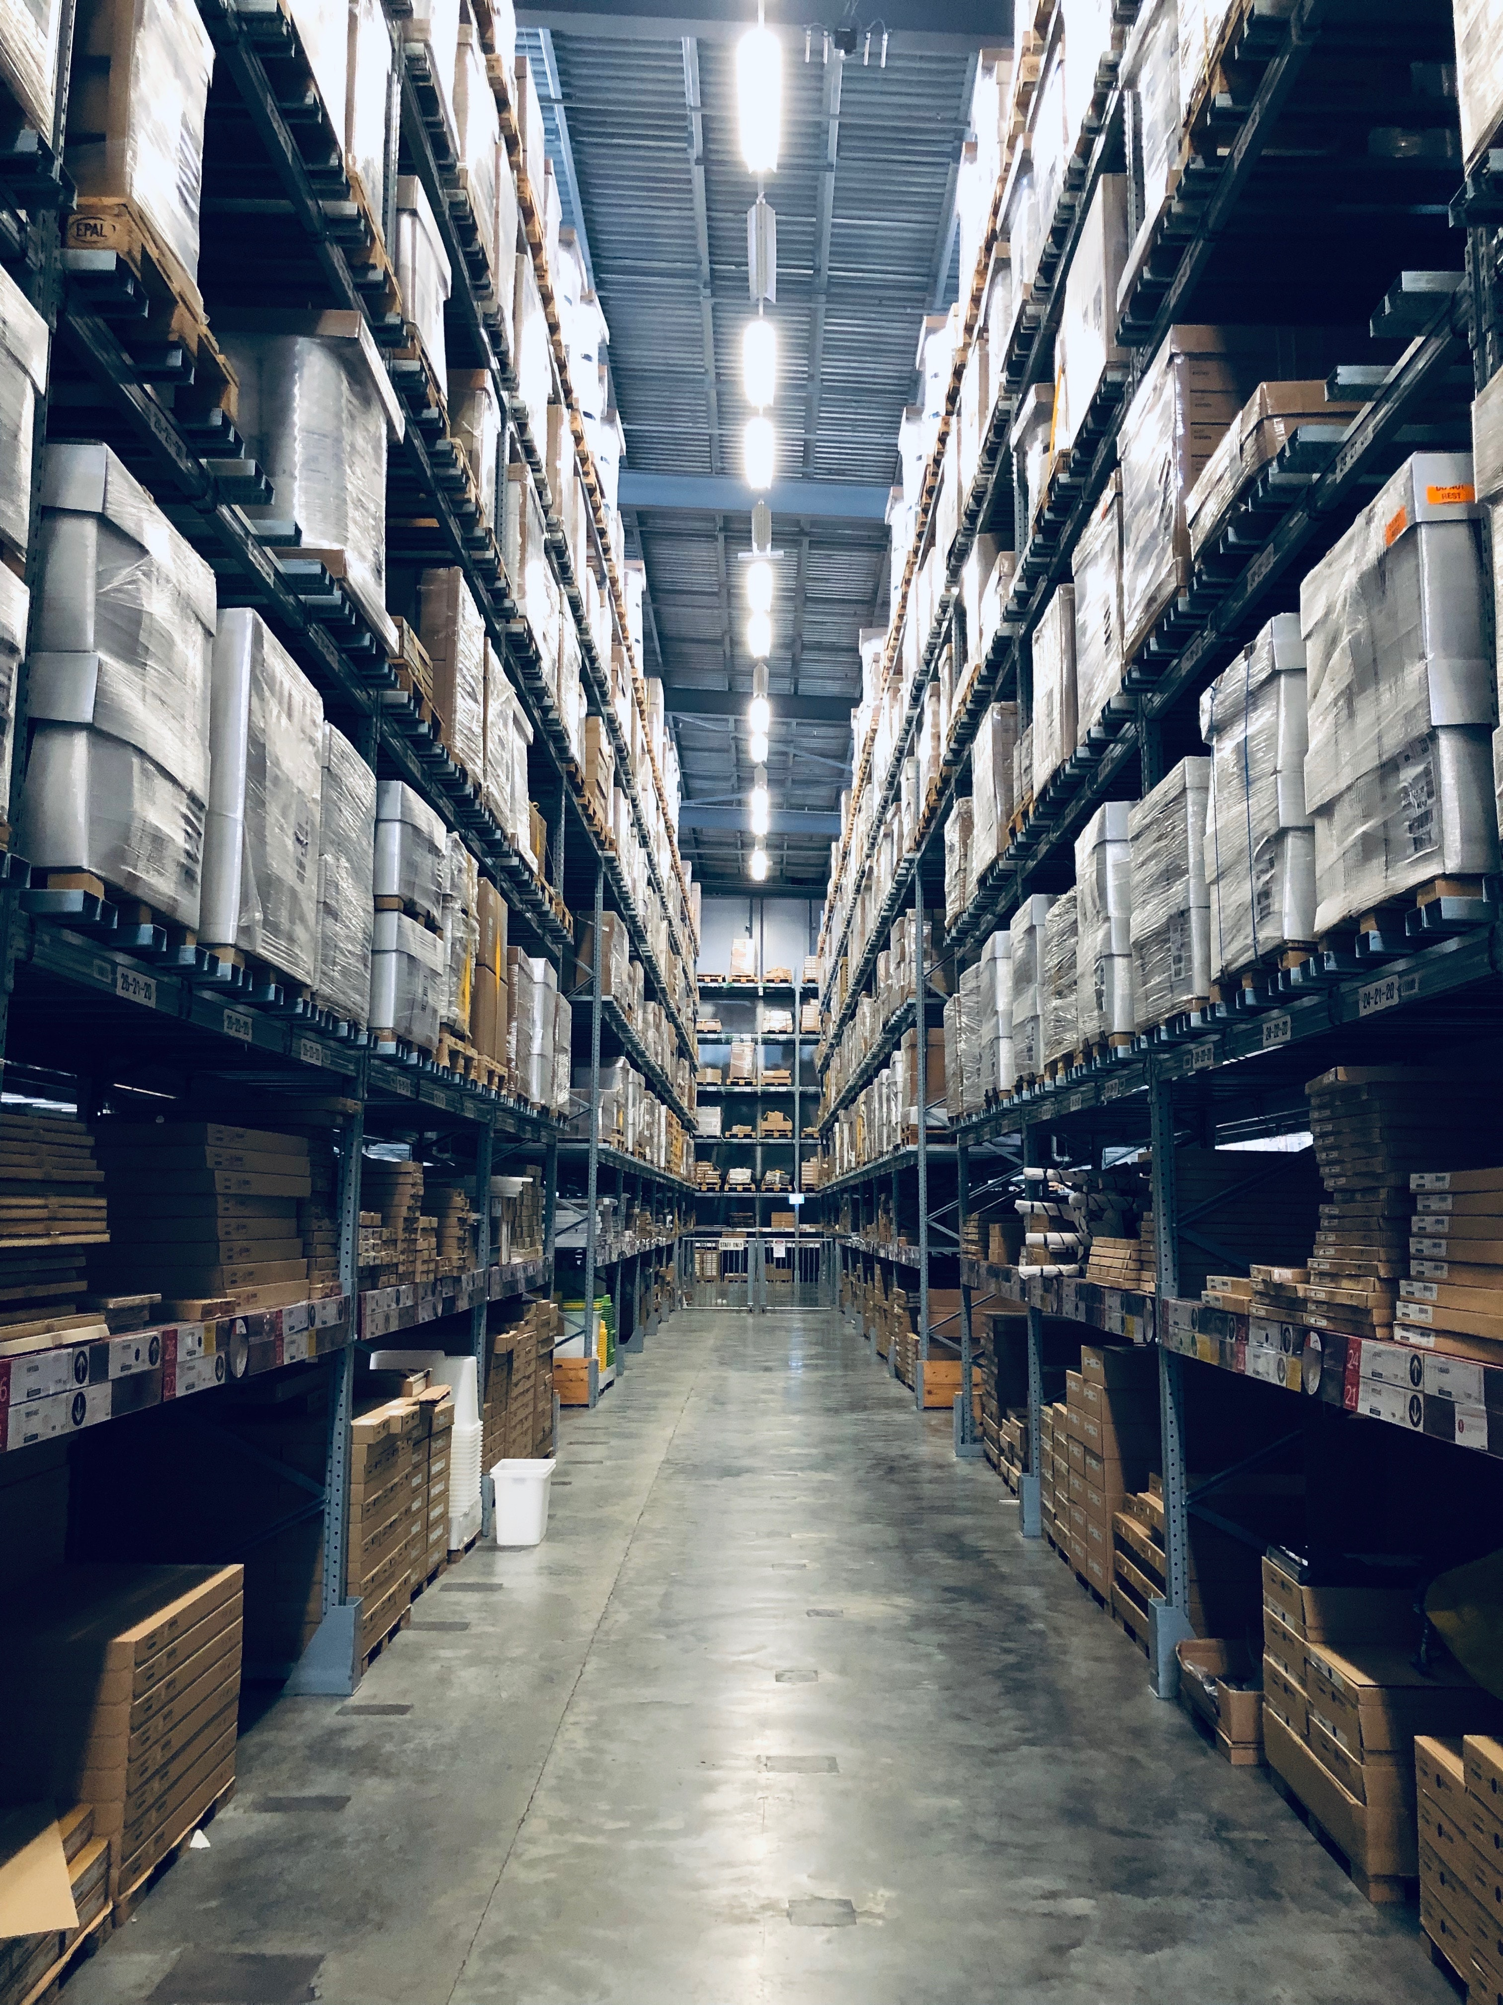
Best performing sectors

Slide 8
Top 3 of all sectors, based on spendings
Package travel gets the cherry with €3,5 billion in expenditure
Package Travel €3,5 billion
Spendings
1
Single airline tickets and accomodation €2,1 billion
Clothes 1,6 billion
2
3

Slide 9
Top 3 of product categories based on spendings
Clothes takes the top spot in product categories
Clothes €1,6 billion
Spendings
1
Food/nearfood €1,2 billion
Shoes & Personal lifestyle €832 million
2
3

Slide 10
Top 3 service categories, based on spendings
Package travel is the most popular service category with €3,5 in spendings
Package Travel €3,5 billion
Spendings
1
Single airline tickets and accomodation €2,1 billion
Tickets for attraction and events €1,1 billion
2
3

Slide 11
Top 3 Product categories growth (vs. 2022)
Household electronics grows the most in spendings
Household electronics +14%
Spendings
1
Media & Entertainment +9,6%
Food/Nearfood +3,5%
2
3

Slide 12
Top 3 Service categories growth (vs. 2022)
The Belgian consumer wants to go out more, and thus spends more on national
National Transportation +31,6%
Spendings
1
Package travel +28,3%
Tickets for attraction and events +25,2%
2
3

Slide 13
Overview of spendings in all sectors
Package travel is the best performing sector of all sectors

Slide 14
Overview of online product spendings 2022 - 2023
Even though most money is spent on Clothes, it has declined in 2023

Slide 15
Overview of online service spendings 2022 - 2023
All services are growing, except Gaming & Gambling

Slide 16
Export

Slide 17
Export Volume
Export has slightly decreased, but the number is still higher than 2021

Slide 18
The Netherlands and France remain the main markets for Belgium.
Germany surpasses the United Kingdom
Export Volume Netherlands €814 million
France €563 million
Germany €138 million
UK €132 million
32.25%

Slide 19
Belgian consumers are buying more cross border than the webshop is selling

Slide 20
Appendix

Slide 21
About Becom
Belgian e-business federation
RELIABLE.
SUSTAINABLE.
INNOVATIVE.

Slide 22
Methodology Market Monitor
Ad Hoc Consumer study
ConsumerScan Panel
Retail Panel
To gain insight into the total market, analyzing the online market in detail, but also relating it to the offline market, several of GfK's data sources are used.
For market segments that are continuously monitored by GfK, this continuous market data is used as a starting point. In addition, ad hoc consumer research is conducted.
The result of the unique combination of these data sources is a complete insight into the total online market in Belgium.
Sample
Persons 15 years of age and older. (At least 4,000 individuals are interviewed each quarter)
Data collection
Online questionnaire.
Representativeness
Market segments for personal purchases are representative of gender, age, social class, and province. Market segments for household purchases are representative of age, household size and province.
Market segments
General topics +Tickets, Sports & Recreation, Travelling, Home & Garden, Fashion, Toys, Insurances, National transportation, and Gaming & Gambling and others. In addition, parts of other market segments.
Sample
Stratified sample of 5,000 private households.
Data collection
Household purchase records using an electronic measuring instrument with integrated scanner.
Representativeness
Weighted variables: household size, age reference person, neighborhood, municipal size, baby population, employment, and retailer market share.
Market segments
FMCG
Sample Representative panel for more than 10,000 outlets, focusing on product sales with broad market coverage.
Data collection Ongoing collection of current sales data from retailers, websites and other commercial outlets.
Representativeness Through combination of sampling and 'census' data very high reliability (90%>)
Market segments Electronics, media & entertainment and telecom

Slide 23
Definitions Market Monitor
Offline Offline purchases include all B2C purchases of products and services made by Belgian consumers in a physical ('bricks-and-mortar') store or store. All prices include VAT.
Online Online purchases include all B2C purchases of products and services made by Belgian consumers via the Internet (online stores and marketplaces). All B2C online purchases of products and services are included, regardless of where the product or service was purchased: at home, at work, on the road, on the high street or in store (online instore). All prices include VAT.
Purchases All purchases made during the specified period where the products/services purchased were retained (not returned or cancelled). One purchase may include the purchase of multiple items. For example: a pair of pants, a t-shirt and a scarf are purchased at the clothing store. This counts as 1 purchase with 3 items.
Expenditure
This is the total amount paid for purchases within the specified period, including VAT. This total amount does not include shipping costs.
Share of online buyers.
The percentage of buyers who made at least one online purchase in the specified market segment during the specified period and this relative to the total number of buyers in this market segment (combination of offline and online).

Slide 24
Methodology E-commerce Barometer
PSPs are companies that process the online payment transactions of online merchants and web shops. They provide webshops with a secure environment in which consumers can pay online, choosing between a wide range of payment methods.
For this barometer study, Becom received, anonymously and under bailiff's orders, the online transaction data of all PSPs listed below. The data include transactions processed by Belgian web shops of both Belgian and foreign customers.
This e-commerce barometer thus answers the question, "How much does the Belgian merchant sell online" - and not "How much does the Belgian consumer buy online." The latter question, however, is answered in the Market Monitor. With the results, Becom, as the Belgian e-commerce federation, wants to provide insight into the evolution of e-commerce realized by Belgian companies*.

Slide 25
Definitions E-commerce Barometer
Micro Online revenue: ≤ € 100,000
Small Online revenue: € 100,001 - € 1,000,000
Medium Online revenue: € 1,000,001 - € 10,000,000
Large Online revenue: > € 10,000,000
Belgian online merchant A company with a Belgian VAT number that sells products or services via the Internet (including mobile). It also has a PSP contract that allows it to accept remote electronic financial transactions.
Online transaction value The value of transactions generated from the sale of goods or services or any other use of capital or assets, related to the main activities of Web merchants, before deduction of costs or expenses. These values may include refunds and chargebacks.
Online financial transaction Transfer of money between customers and sellers, including refunds and chargebacks.
Cross-border transaction value The value of transactions generated abroad from the sale of goods or services or any other use of capital or assets, related to the main activities of online merchants, before deduction of costs or expenses. These values may include refunds and chargebacks.
Direct Debit Bancontact, Bank Buttons, Maestro, iDEAL, Sofort, Giropay, ...
Credit cards Visa, Mastercard, Amex, ...
Classic SEPA Direct Debit, Wire Transfer, ...
New Paypal, Alipay, Bitcoin, Google Pay
Specifc Afterpay, Klarna, PaySafeCard, Gift cards, Pluxee,

